Slide 1

Data Compression – Comparing Haar Algorithms
Presenters: Liel Berniker, Noy Osi, Dvir Segal Instructor: Prof. Dana Shapira

Slide 2
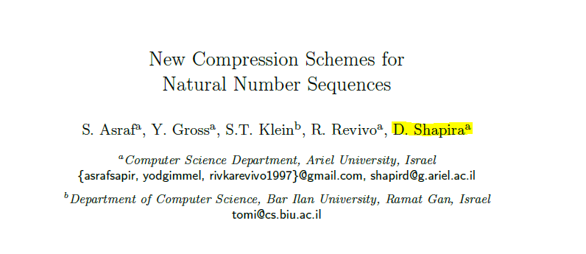
Sources:

Slide 3

What is data compression?
Data compression is the process of encoding, restructuring or otherwise modifying data in order to reduce its size

Slide 4
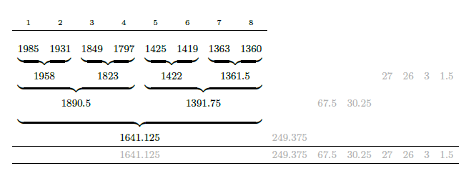
Haar wavelet transform
The Haar wavelet transform is a simple discrete transform, used in practical encoding applications such as the compression of digitized sound and images.
Here it is applied for lossless compression of integer sequences.

Slide 5

Haar algorithms:
Haar Integer
Haar New Transform.

Slide 6
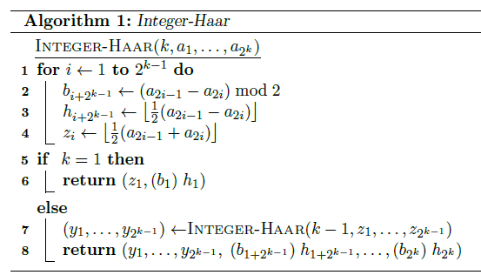
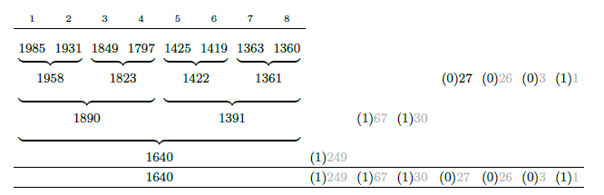
Integer-Haar:
Integer-Haar: To restrict the processing to deal with integers only,
a single flag bit can be adjoined to every half-difference,
indicating whether or not the value has been rounded downwards.
Example 1:

Slide 7
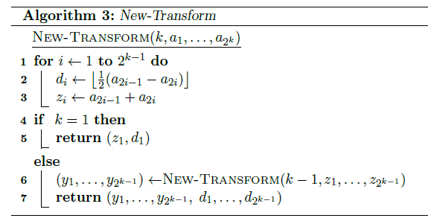







Haar New Transform :
Haar New Transform: Instead of computing the averages of the number pairs in the input sequence,
it only sums up the corresponding elements.
Example 2:

Slide 8

Encoding algorithms

Slide 9
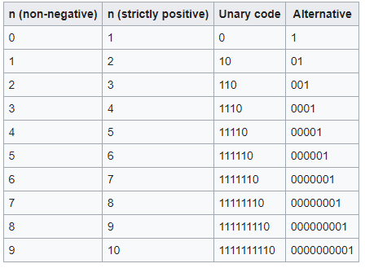
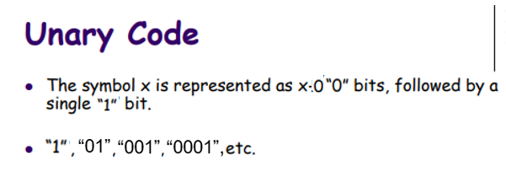
Unary coding

Slide 10
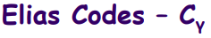
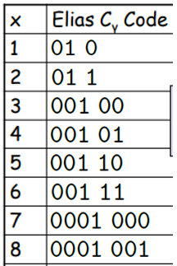
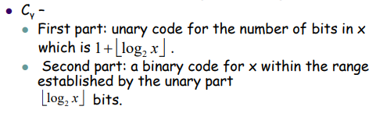
Elias Codes – C gamma

Slide 11
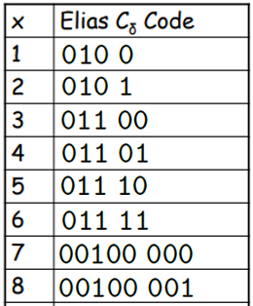
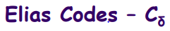
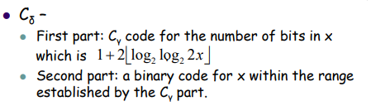
Elias Codes – C delta

Slide 12

graphs & charts:

Slide 13
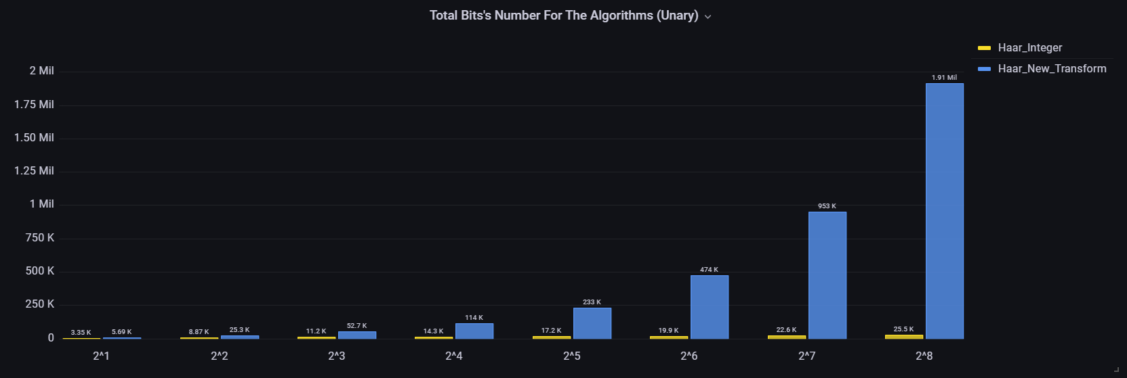
Unary code – average bit size compare:

Slide 14
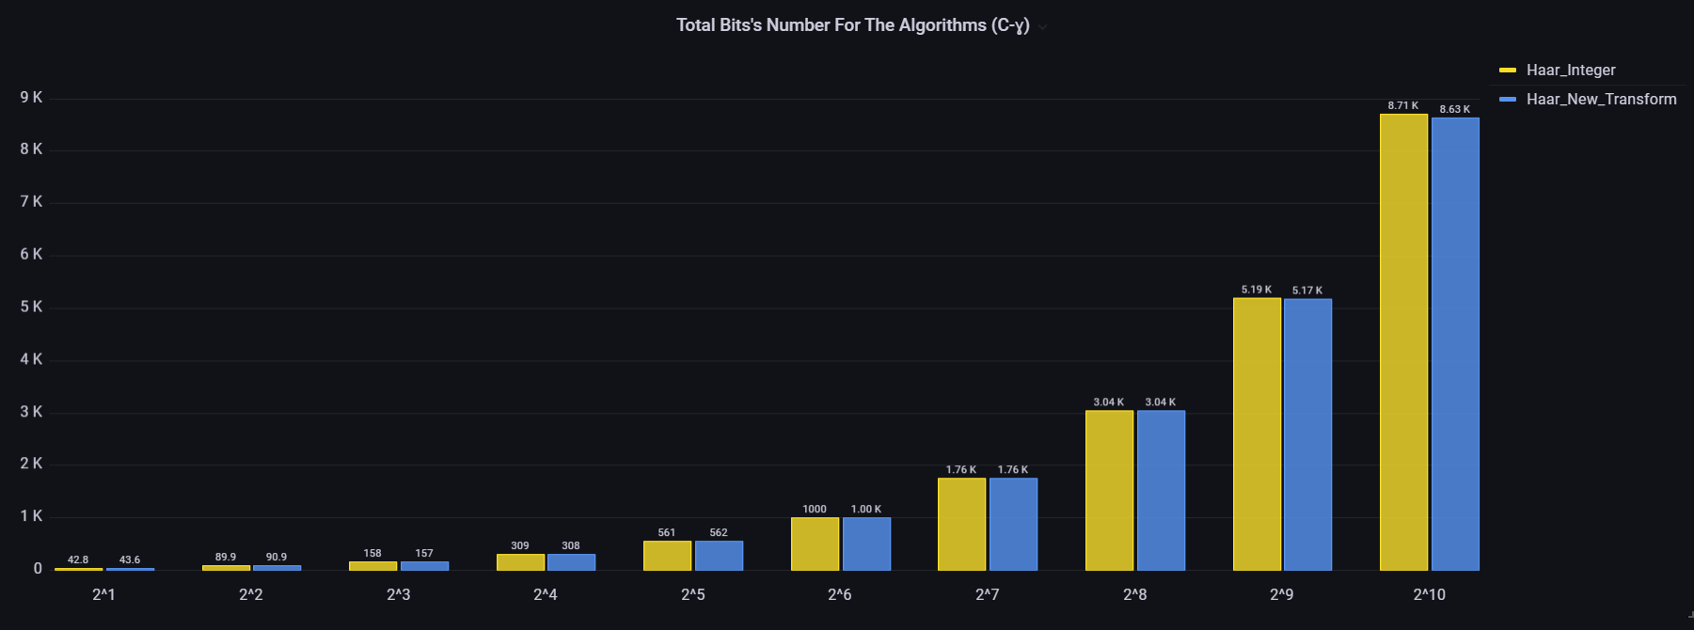
C Gamma code – average bit size compare:

Slide 15
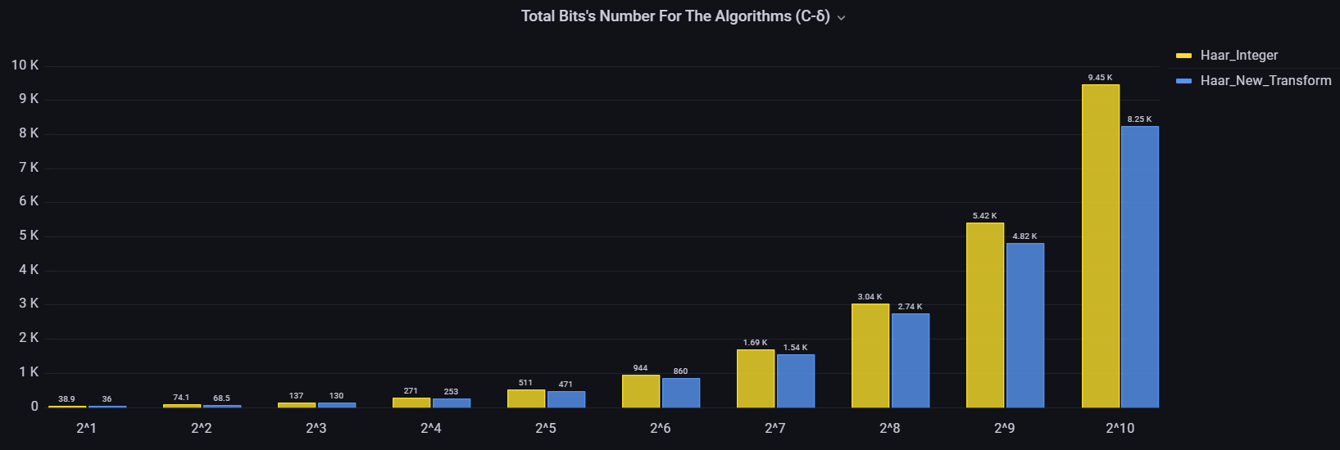
C Delta code – average bit size compare:

Slide 16
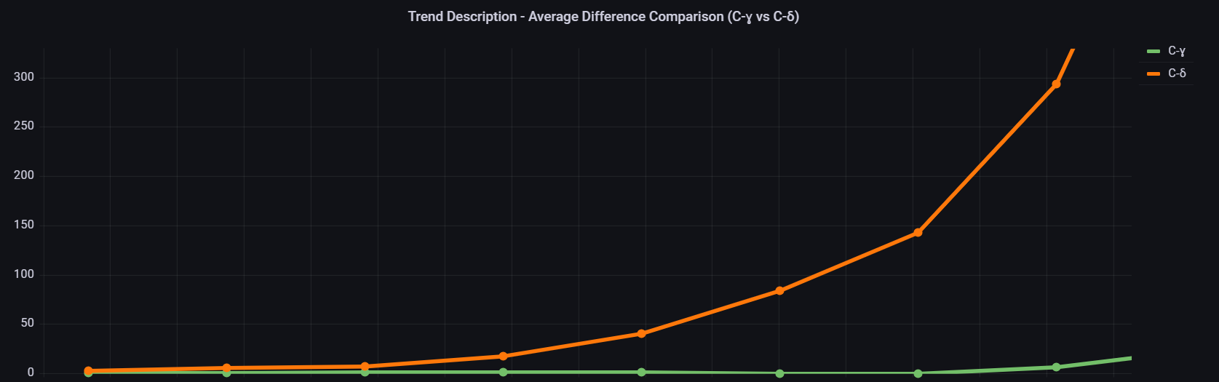
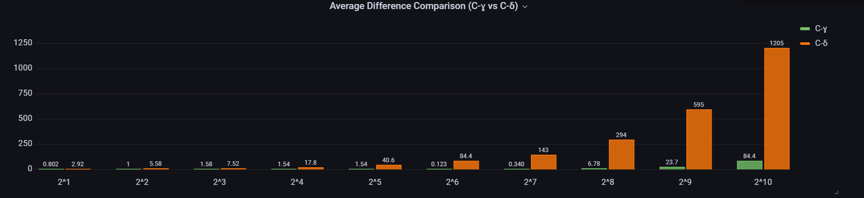
comparison of bit size savings, between haar integer and haar new transform

Slide 17
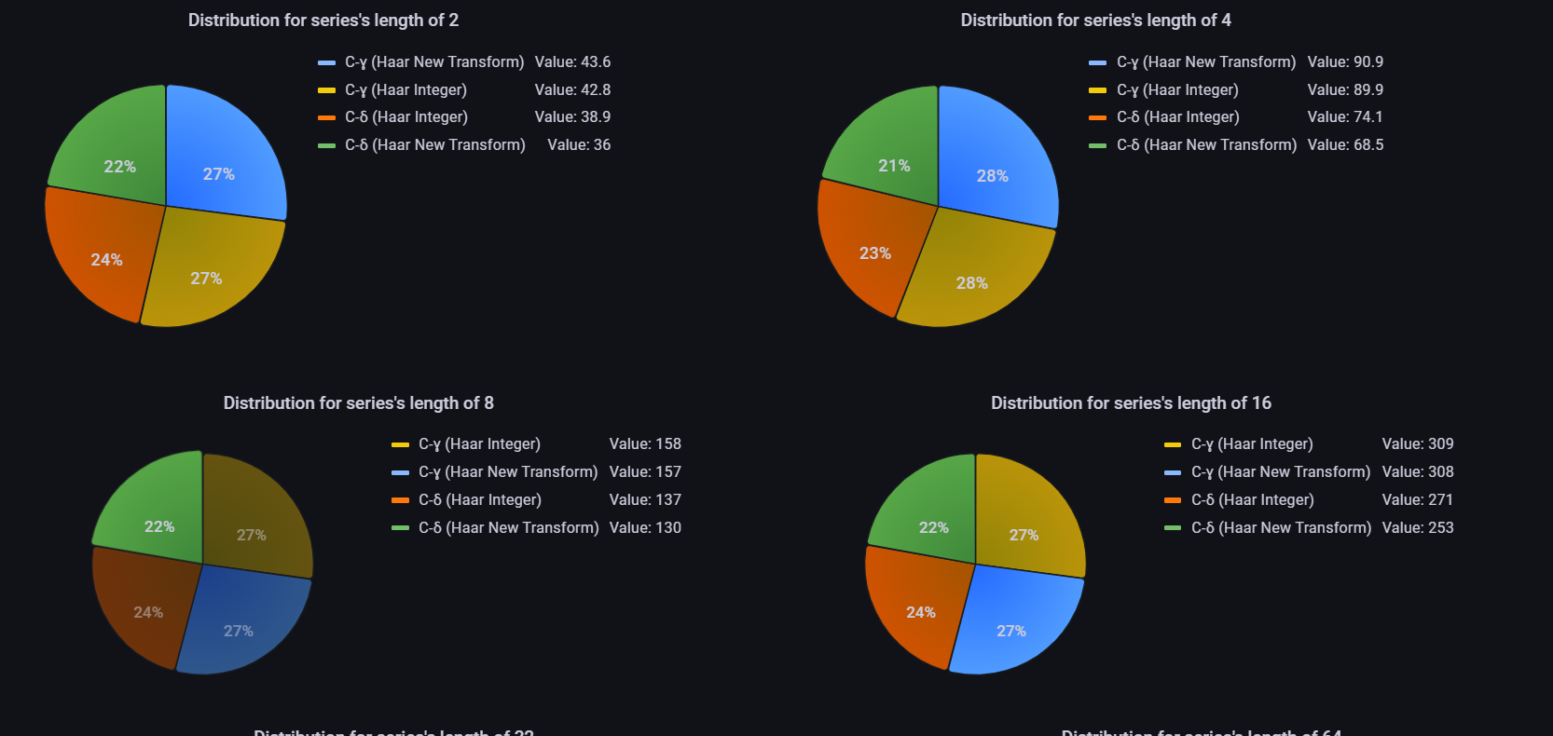
Distribution for different types of coding (series length 2^1 – 2^4)

Slide 18
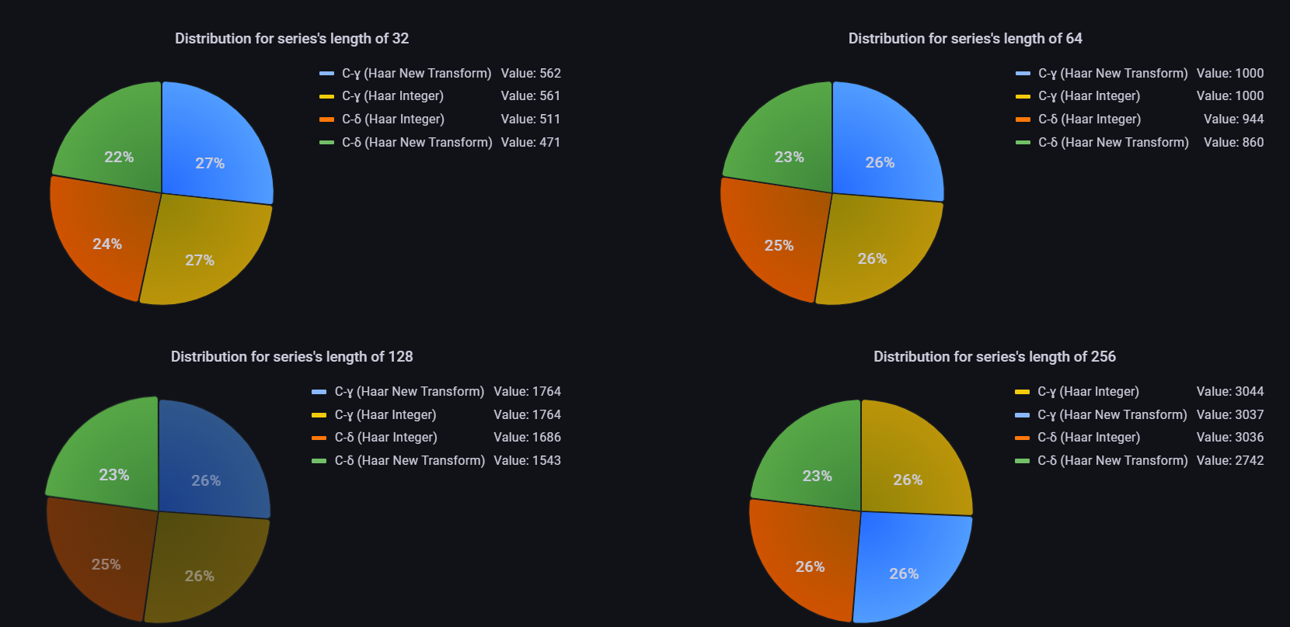
Distribution for different types of coding (series length 2^5 – 2^8)

Slide 19
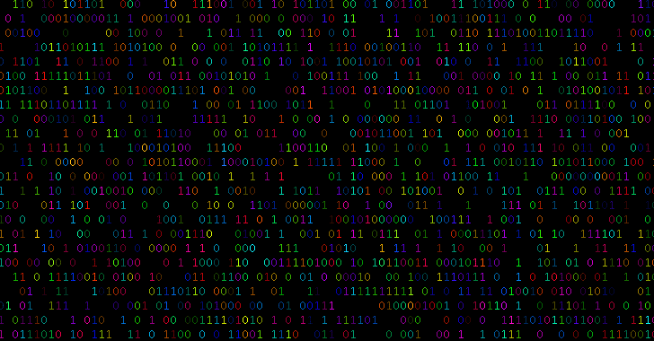
The End
Check our GitHub : https://github.com/Dvir-Segal/Data-Compression.git

